Slide 1
Water Supply Systems: Water Budgets and Groundwater Assessments

Slide 2
Three Quantitative Pieces
1. Hydrologic Budgets
2. Darcy’s Law
3. Theis Equations

Slide 3
The Water Budget
INFLOW = OUTFLOW +/- CHANGE IN STORAGE
Inflows: Precipitation + SW inflow + GW inflow + imported water
Outflows: ET + SW out + GW out + Exports + consumption
Storage: Increased/decrease in SW storage + increase/decreases in GW storage
Notes:
http://www.unep.org/dewa/vitalwater/index.html
Evapotranspiration (ET) is the sum of evaporation and plant transpiration from the Earth's land and ocean surface to the atmosphere.

Slide 4
Darcy’s Law
Darcy: Made first systematic study of movement of water through a porous medium and the first to state the simple law describing GW flow (1856)
Head Difference
Q = K
Area = KiA
Distance between Heads
Q = Volumetric discharge (L³/t)
i = Hydraulic Gradient (L/L)
K = Hydraulic conductivity (L/t)
Notes:
Hydraulic head : a measure of the potential of water at the measurement point
Hydraulic head is a measurement of the total mechanical energy per weight of the groundwater flow system. In other words, it is the fluid potential for flow through porous media. It is predominantly comprised of pressure and elevation heads.
Hydraulic conductivity: a soil’s ability to transmit water when subjected to a gradient

Slide 5
Theis Equations
Theis: set of equations that describe the amount of drawdown created by a pumping well over a specific time period
Q
S =
W(u)
4πT
S = drawdown at any time and distance from a pumping well (L)
Q = discharge from pumping well (L³/t)
T = transmissivity of the aquifer (L²/t)
W(u) = Theis well function (unitless)
Notes:
Transmissivity: rate of flow of water through a vertical strip of an aquifer

Slide 6
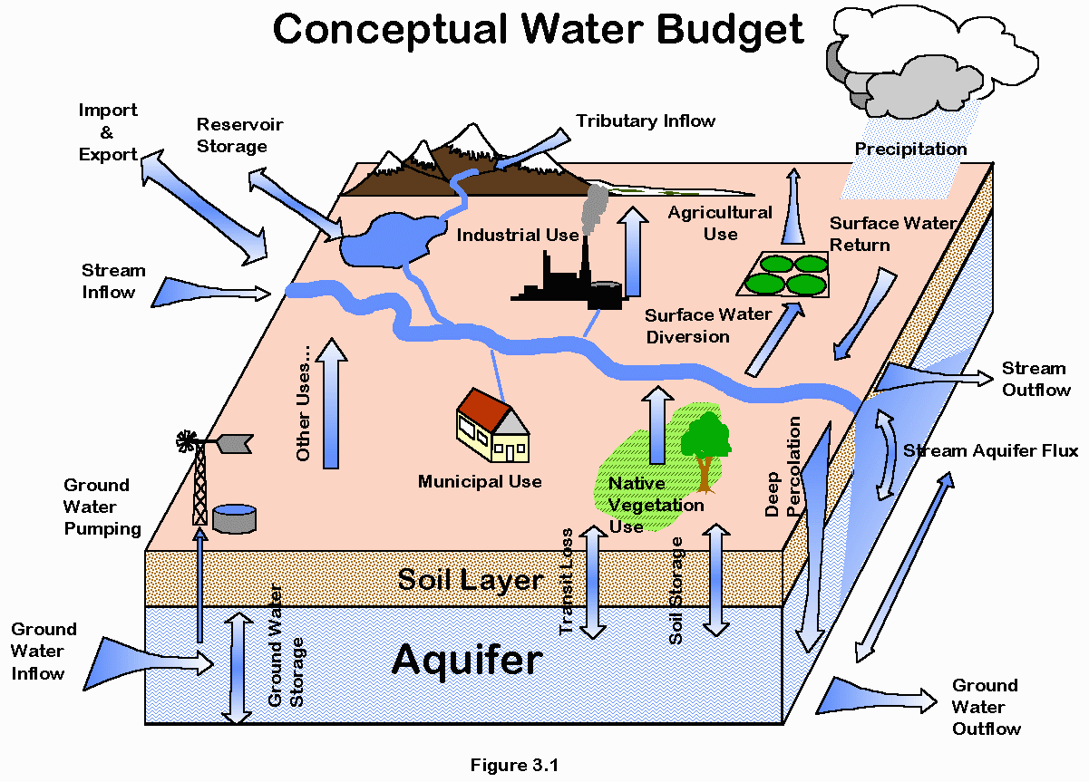
The Water Budget
The relationship between inputs and outputs of water through a region
Uses principles of conservation of mass in a closed system
Can help to manage a water supply
Notes:
This equation uses the principles of conservation of mass in a closed system, whereby any water entering a system (via precipitation), must be transferred into either evaporation, surface runoff (eventually reaching the channel and leaving in the form of river discharge), or stored in the ground. This equation requires the system to be closed, and where it isn't (for example when surface runoff contributes to a different basin), this must be taken into account.

Slide 7
The Water Budget
Can be calculated for any domain:
Atmosphere
Ocean
Continent
Watershed: MOST TYPICAL
Stream segment
Lake
Geopolitical entities (state, country, etc.)
Notes:
http://www.unep.org/dewa/vitalwater/index.html

Slide 8
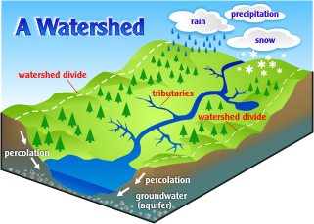
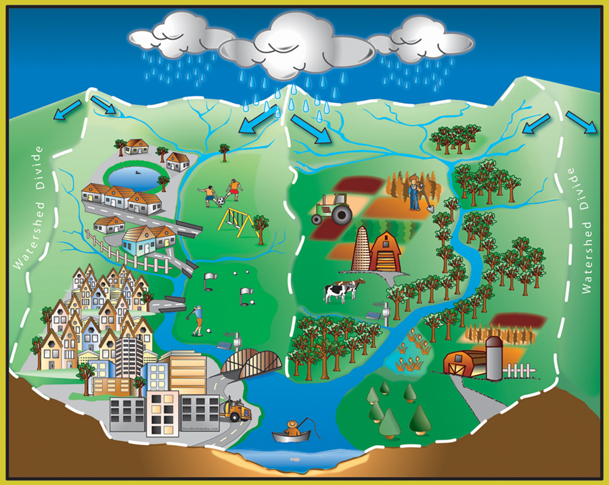
Water Budget for Watershed
Watershed: A watershed is an area of land that drains all the streams and rainfall to a common outlet such as the outflow of a reservoir, mouth of a bay, or any point along a stream channel.
Notes:
USGS: A watershed is an area of land that drains all the streams and rainfall to a common outlet such as the outflow of a reservoir, mouth of a bay, or any point along a stream channel. The word watershed is sometimes used interchangeably with drainage basin or catchment.

Slide 9
The Water Budget
TERMS
Precipitation: Any form of solid or liquid water that falls from the atmosphere to the Earth’s surface
Evapotranspiration: Process that returns water back to the atmosphere
Evaporation from open water (lakes, etc.)
Evaporation from soils (deserts, mountains, etc.)
Transpiration from plants (evaporation from within leaves)
Groundwater: water held underground in the soil or in pores and crevices in rock
Surface Water: water that has not penetrated below the surface of the ground
Notes:
http://www.unep.org/dewa/vitalwater/index.html
Evapotranspiration (ET) is the sum of evaporation and plant transpiration from the Earth's land and ocean surface to the atmosphere.

Slide 10
Setting up a Water Budget Equation
Similar to accounting for your personal finances
Track income and expenses
See change in “storage” of your bank account
All inputs, outputs, and changes must be identified
What is your conceptual model??
What are the uncertainties?
Notes:
Conceptual model: a type of diagram which shows of a set of relationships between factors that are believed to impact or lead to a target condition; a diagram that defines theoretical entities, objects, or conditions of a system and the relationships between them

Slide 11
The Water Budget
INFLOW = OUTFLOW +/- CHANGE IN STORAGE
Inflows: Precipitation + SW inflow + GW inflow + imported water
Outflows: ET + SW out + GW out + Exports + consumption
Storage: Increased/decrease in SW storage + increase/decreases in GW storage
Notes:
http://www.unep.org/dewa/vitalwater/index.html
Evapotranspiration (ET) is the sum of evaporation and plant transpiration from the Earth's land and ocean surface to the atmosphere.

Slide 12
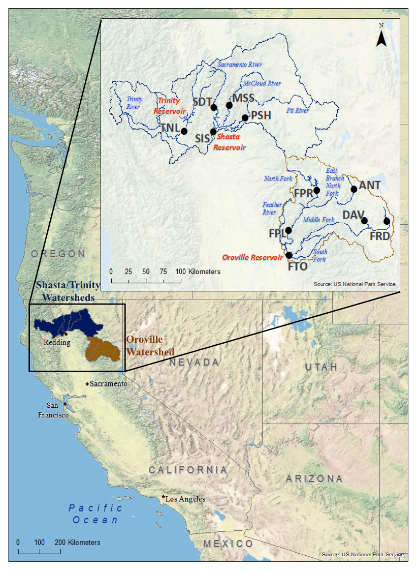
Water Budget for Upper Feather River Watershed
Area: 3,600 mi² ≈ 9,300 km²
Average precipitation = 45 inches/year
Average ET = 20 inches/year
SW inflows:
SW Outflows: 2.3% of total inflows ≈ 122.13 cfs
Notes:
Located in northern California
Feather River: main water supply to the Oroville Reservoir
State Water Project
Provides water to over 25 million Californians
Can store 3.5 MAF

Slide 13
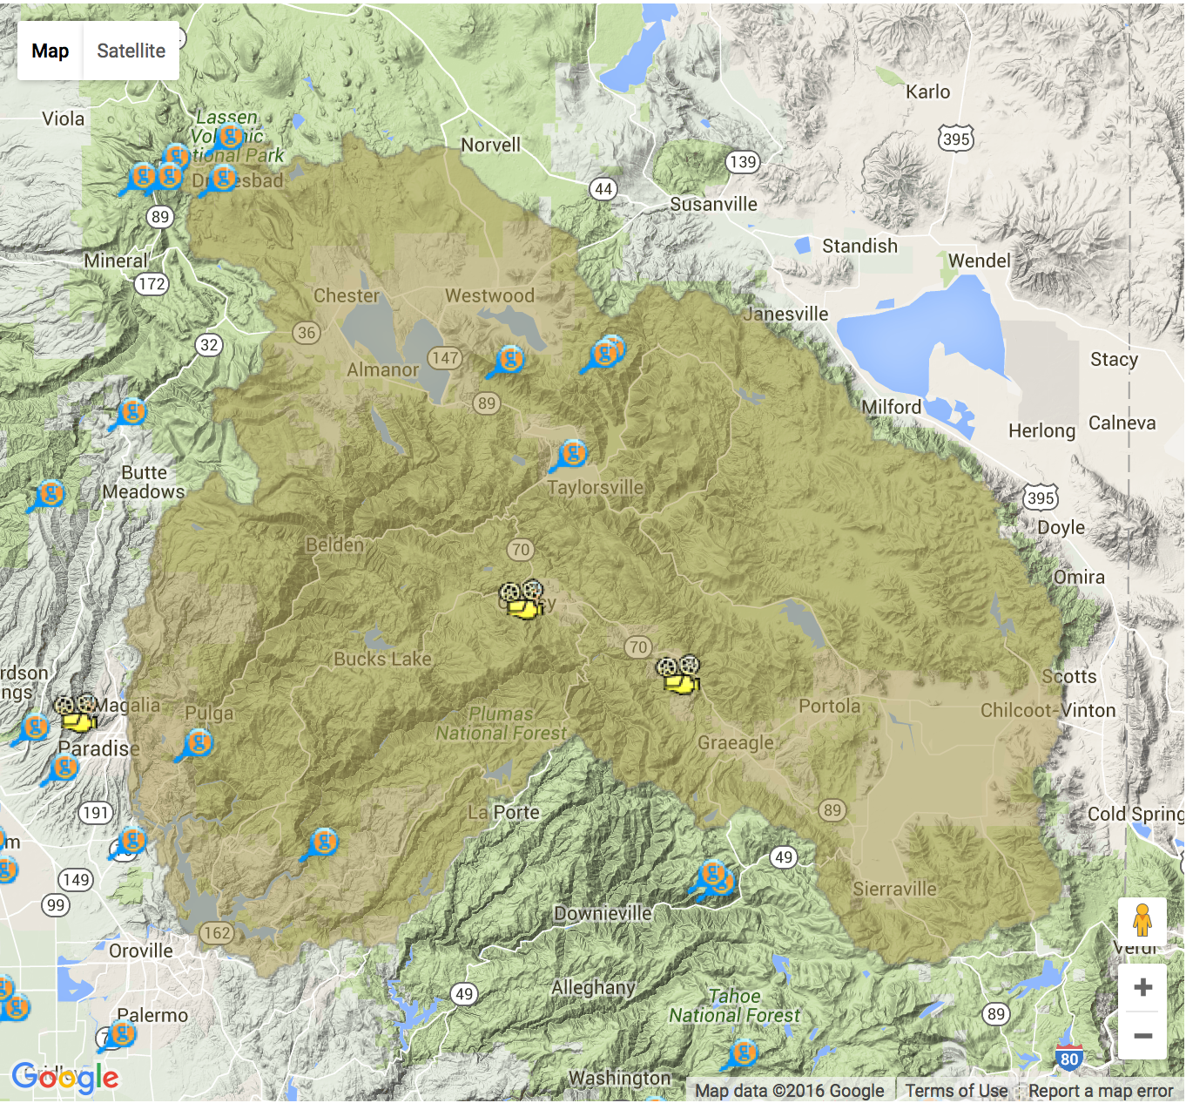
Water Budget for Upper Feather River Watershed
Average exports from Oroville Reservoir: 2.8 MAF
Average change in GW storage: 3 inches/year
Assumptions:
No GW inflow or outflow
No imported water
Exports of Oroville Reservoir = total watershed exports
What is the change in surface water storage in MAF per year???

Slide 14
The Water Budget
INFLOW = OUTFLOW +/- CHANGE IN STORAGE
Inflows: Precipitation + SW inflow + GW inflow + imported water
Outflows: ET + SW out + GW out + Exports + consumption
Storage: Increase/decrease in SW storage + increase/decrease in GW storage
Notes:
http://www.unep.org/dewa/vitalwater/index.html
Evapotranspiration (ET) is the sum of evaporation and plant transpiration from the Earth's land and ocean surface to the atmosphere.

Slide 15
The Water Budget
Helpful Conversions:
1 foot = 12 inches
1 mile = 5,280 ft
1 mile² = 2.7x10⁷ ft²
1 Acre = 43,560 ft²
Notes:
http://www.unep.org/dewa/vitalwater/index.html
Evapotranspiration (ET) is the sum of evaporation and plant transpiration from the Earth's land and ocean surface to the atmosphere.

Slide 16
INFLOWS:
Precipitation + SW inflow + GW inflow + Imported water
OUTFLOWS:
ET + SW out + GW out + Exports
STORAGE:
Change (Δ) in SW Storage + Change (Δ) in GW Storage

Slide 17
INFLOWS:
Precipitation + SW inflow + GW inflow + Imported water
XXXX AFY +
OUTFLOWS:
ET + SW out + GW out + Exports
STORAGE:
Change (Δ) in SW Storage + Change (Δ) in GW Storage

Slide 18
Precipitation:
45 inches/year…..how to get this in AFY?
Note: Area = 3,600 mi²

Slide 19
INFLOWS:
Precipitation + SW inflow + GW inflow + Imported water
8.62x10⁶ AFY + XXXX AFY
OUTFLOWS:
ET + SW out + GW out + Exports
STORAGE:
Change (Δ) in SW Storage + Change (Δ) in GW Storage

Slide 20
SW Inflows:
5,301 cfs
*Note: The snowmelt contribution to the streamflow is included in this estimate

Slide 21
INFLOWS:
Precipitation + SW inflow + GW inflow + Imported water
8.62x10⁶ AFY + 3.83x10⁶ AFY + XXXX AFY + XXXX AFY
OUTFLOWS:
ET + SW out + GW out + Exports
STORAGE:
Change (Δ) in SW Storage + Change (Δ) in GW Storage

Slide 22
INFLOWS:
Precipitation + SW inflow + GW inflow + Imported water
8.62x10⁶ AFY + 3.83x10⁶ AFY + 0 AFY + 0 AFY
OUTFLOWS:
ET + SW out + GW out + Exports
STORAGE:
Change (Δ) in SW Storage + Change (Δ) in GW Storage

Slide 23
INFLOWS:
Precipitation + SW inflow + GW inflow + Imported water
8.62x10⁶ AFY + 3.83x10⁶ AFY + 0 AFY + 0 AFY
OUTFLOWS:
ET + SW out + GW out + Exports
XXXX AFY
STORAGE:
Change (Δ) in SW Storage + Change (Δ) in GW Storage

Slide 24
Evapotranspiration:
20 inches/year
Note: Area = 3,600 mi²

Slide 25
INFLOWS:
Precipitation + SW inflow + GW inflow + Imported water
8.62x10⁶ AFY + 3.83x10⁶ AFY + 0 AFY + 0 AFY
OUTFLOWS:
ET + SW out + GW out + Exports
3.83x10⁶ AFY + XXXX AFY
STORAGE:
Change (Δ) in SW Storage + Change (Δ) in GW Storage

Slide 26
SW Outflows:
122.31 cfs

Slide 27
INFLOWS:
Precipitation + SW inflow + GW inflow + Imported water
8.62x10⁶ AFY + 3.83x10⁶ AFY + 0 AFY + 0 AFY
OUTFLOWS:
ET + SW out + GW out + Exports
3.83x10⁶ AFY + 8.85x10⁴ AFY + XXXX AFY
STORAGE:
Change (Δ) in SW Storage + Change (Δ) in GW Storage
Δ SW Storage + 109.09 AFY

Slide 28
INFLOWS:
Precipitation + SW inflow + GW inflow + Imported water
8.62x10⁶ AFY + 3.83x10⁶ AFY + 0 AFY + 0 AFY
OUTFLOWS:
ET + SW out + GW out + Exports
3.83x10⁶ AFY + 8.85x10⁴ AFY + 0 AFY +XXXX AFY
STORAGE:
Change (Δ) in SW Storage + Change (Δ) in GW Storage

Slide 29
INFLOWS:
Precipitation + SW inflow + GW inflow + Imported water
8.62x10⁶ AFY + 3.83x10⁶ AFY + 0 AFY + 0 AFY
OUTFLOWS:
ET + SW out + GW out + Exports
3.83x10⁶ AFY + 8.85x10⁴ AFY + 0 AFY + 2.8x10⁶AFY
STORAGE:
Change (Δ) in SW Storage + Change (Δ) in GW Storage
XXXX AFY

Slide 30
Change in GW Storage:
3 inches/year
Note: Area = 3,600 mi²

Slide 31
INFLOWS:
Precipitation + SW inflow + GW inflow + Imported water
8.62x10⁶ AFY + 3.83x10⁶ AFY + 0 AFY + 0 AFY
OUTFLOWS:
ET + SW out + GW out + Exports
3.83x10⁶ AFY + 8.85x10⁴ AFY + 0 AFY + 2.8x10⁶AFY
STORAGE:
Change (Δ) in SW Storage + Change (Δ) in GW Storage
Δ SW Storage + 5.74x10⁶ AFY

Slide 32
INFLOWS:
Precipitation + SW inflow + GW inflow + Imported water
8.62x10⁶ AFY + 3.83x10⁶ AFY + 0 AFY + 0 AFY = 12453451.25 = 1.25x10⁷ AFY
OUTFLOWS:
ET + SW out + GW out + Exports
3.83x10⁶ AFY + 8.85x10⁴ AFY + 0 AFY + 2.8x10⁶AFY = 6722340.86 = 6.72x10⁶ AFY
STORAGE:
Change (Δ) in SW Storage + Change (Δ) in GW Storage
Δ SW Storage + 5.74x10⁶ AFY

Slide 33
INFLOW = OUTFLOW +/- CHANGE IN STORAGE
12453451.25 AFY = 6722340.86 AFY + 5379669.42 AFY + ΔSW Storage
12453451.25 AFY = 12102010.28 AFY +ΔSW Storage
ΔSW Storage = 351440.97 AFY or 0.35 MAFY
ΔSW Storage = 0.35 MAF per year

Slide 34
Analysis
So what does this change in storage mean?
What would happen in a drought year or during multiple drought years?
How can this information be used for supply management?
What else would reservoir operators need to know?

Slide 35
Groundwater Sustainability
Definition: groundwater use that can be maintained for an indefinite time without causing enviornmental, social, or economic adverse consequences
Jason Gurdak (my Hydrogeology professor at SFSU)

Slide 36
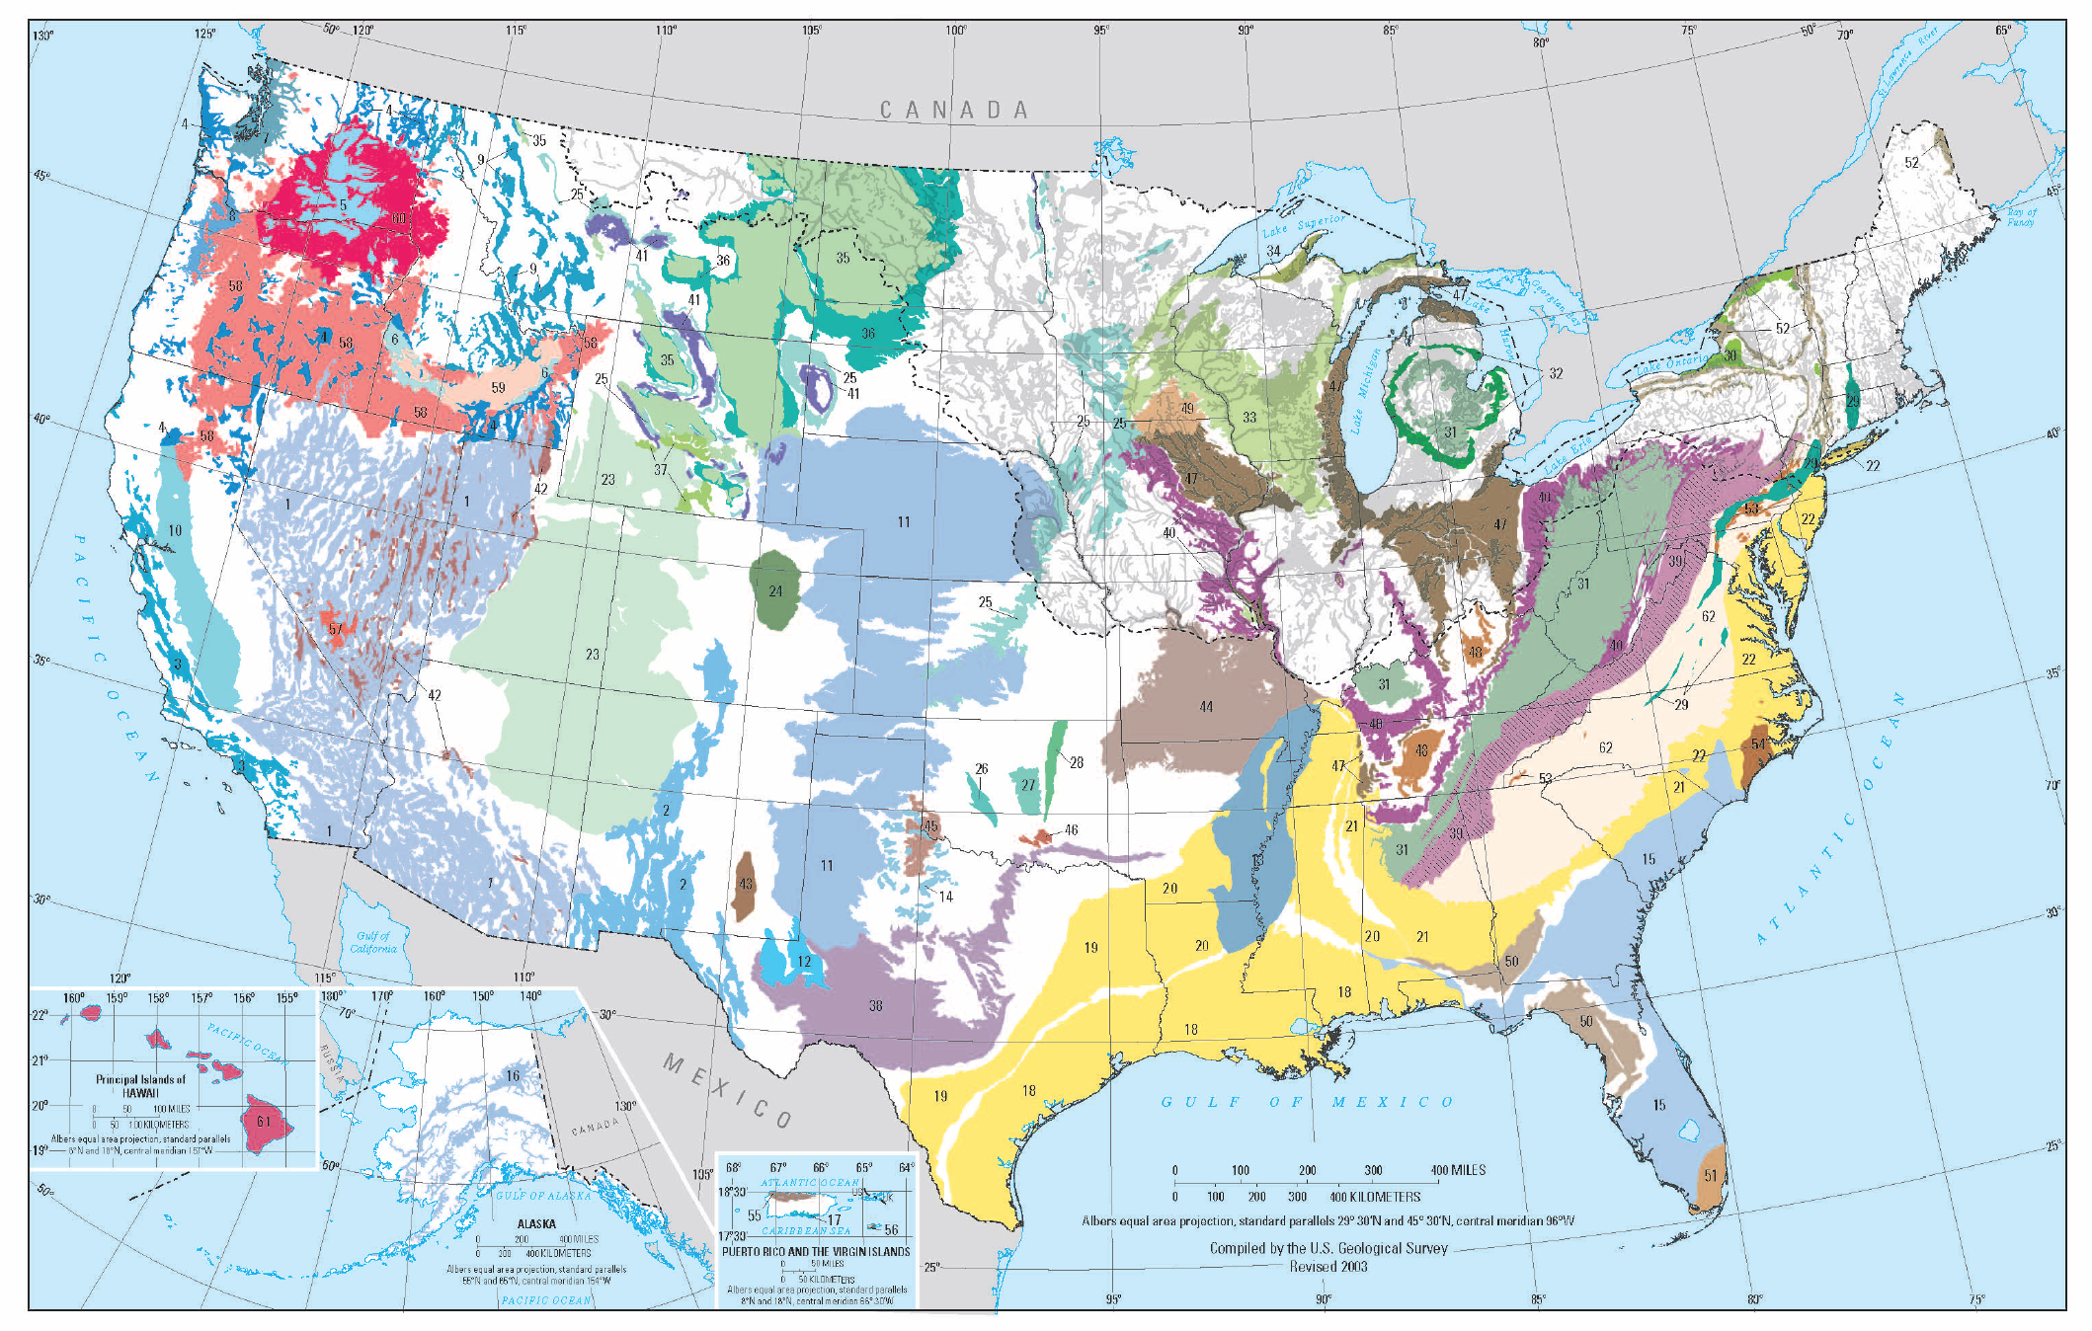
Groundwater Resources
Aquifer: a layer of rock, sand, or earth that contains water or allows water to pass through it.

Slide 37
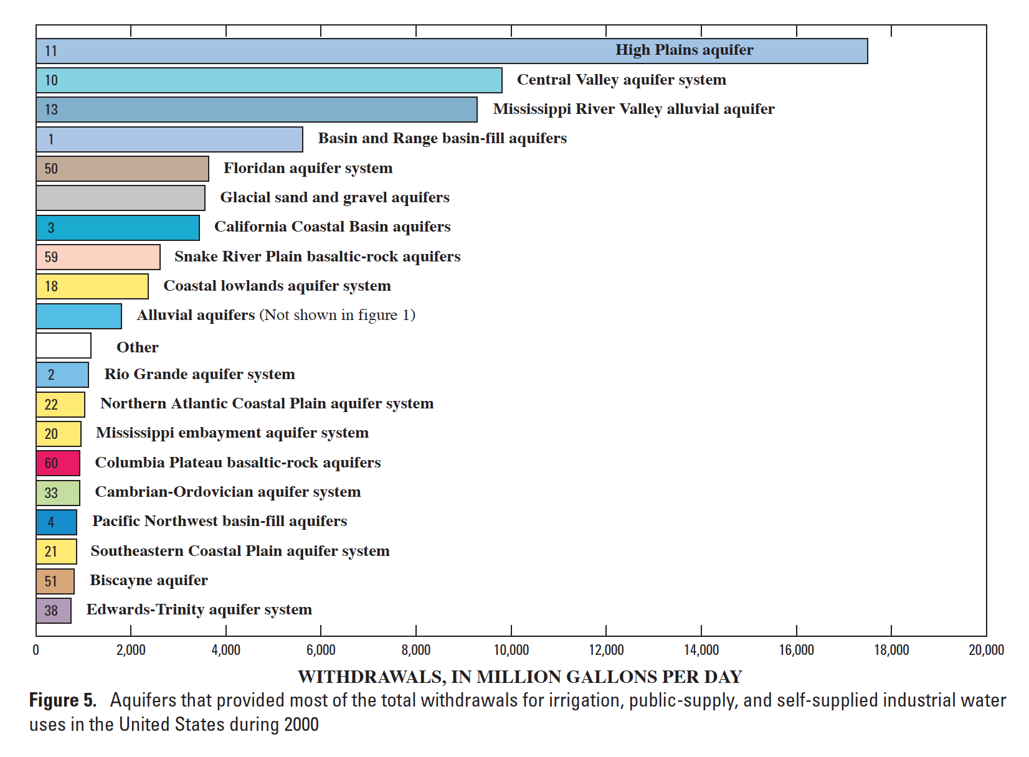
Groundwater Resources

Slide 38
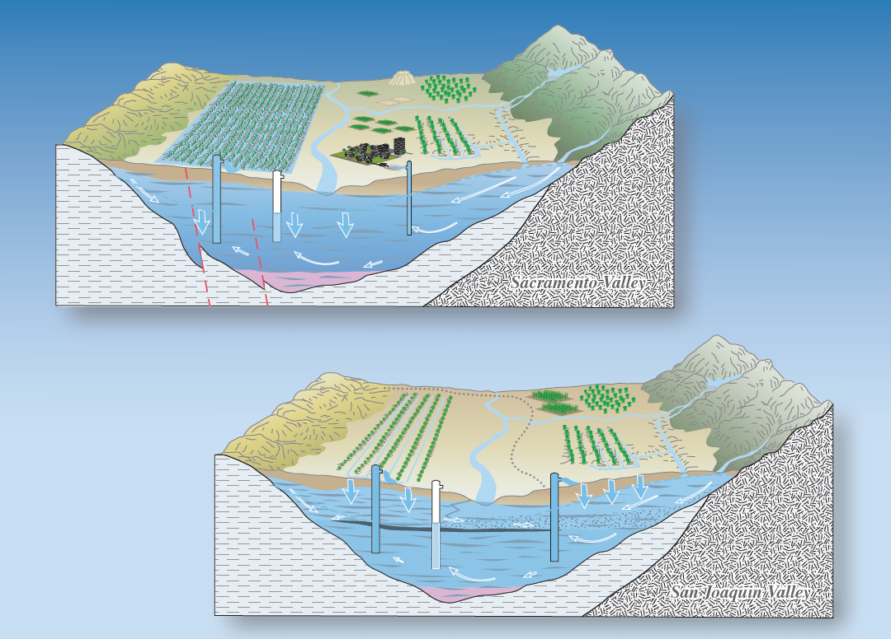
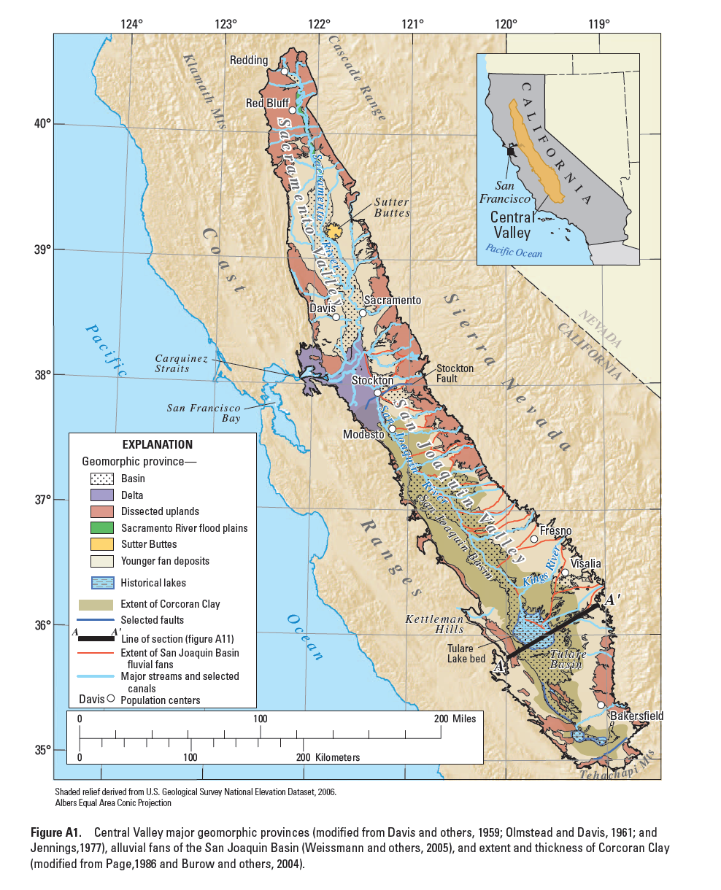
California’s Groundwater
Notes:
Need to look up geological history of the region

Slide 39
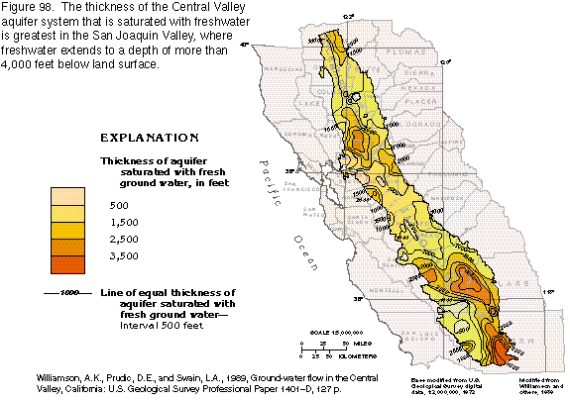
California’s Groundwater

Slide 40
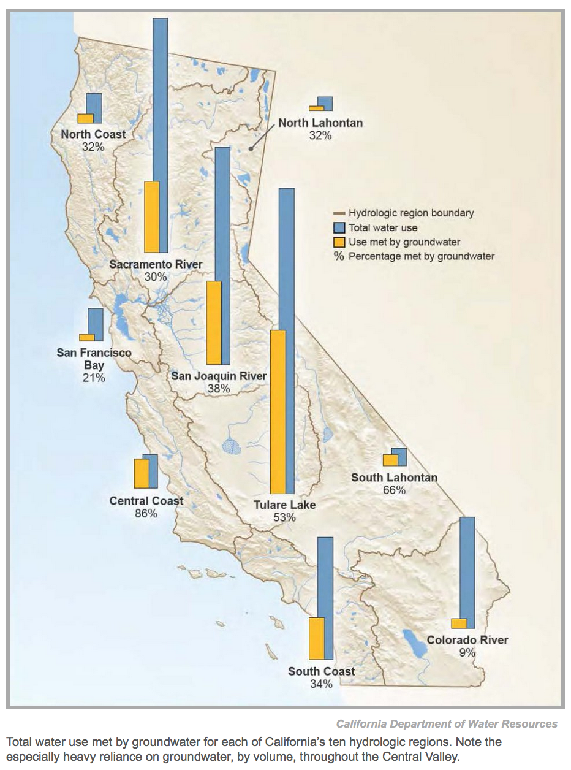
California’s Groundwater
Groundwater contributes to approximately 38% of CA water supply
46% in drought years
75% estimated for 2014
5.1 MAF of the 6.6 average availability
Notes:
Groundwater resources play a vital role in maintaining California's economic and environmental sustainability. During an average year, California's 515 alluvial groundwater basins and subbasins contribute approximately 38 percent toward the State's total water supply. During dry years, groundwater contributes up to 46 percent (or more) of the statewide annual supply, and serves as a critical buffer against the impacts of drought and climate change. Many municipal, agricultural, and disadvantaged communities rely on groundwater for up to 100 percent of their water supply needs. Groundwater extraction in excess of natural and managed recharge has caused historically-low groundwater elevations in many regions of California.

Slide 41
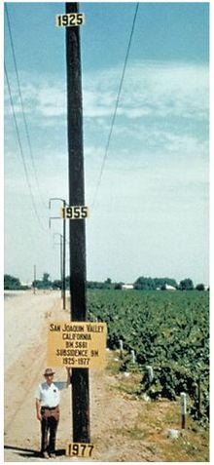
Groundwater Pumping
Subsidence: Land subsidence is the lowering of the land-surface elevation from changes that take place underground
Common causes:
Pumping of water, oil, gas
Dissolution of limestone aquifers
Collapse of underground mines
Left: Location of 1977 maximum subsidence in the United States identified by Dr. Joseph F. Poland (pictured). Signs on pole show approximate altitude of land surface in 1925, 1955, and 1977. San Joaquin Valley southwest of Mendota, California. Credit: Dick Ireland, USGS.

Slide 42
Data Needs for Sustainable Groundwater Mgmt
Soil type
Water table level
Number of wells
Pumping rates
What else????
How do we simplify a complex system?

Slide 43
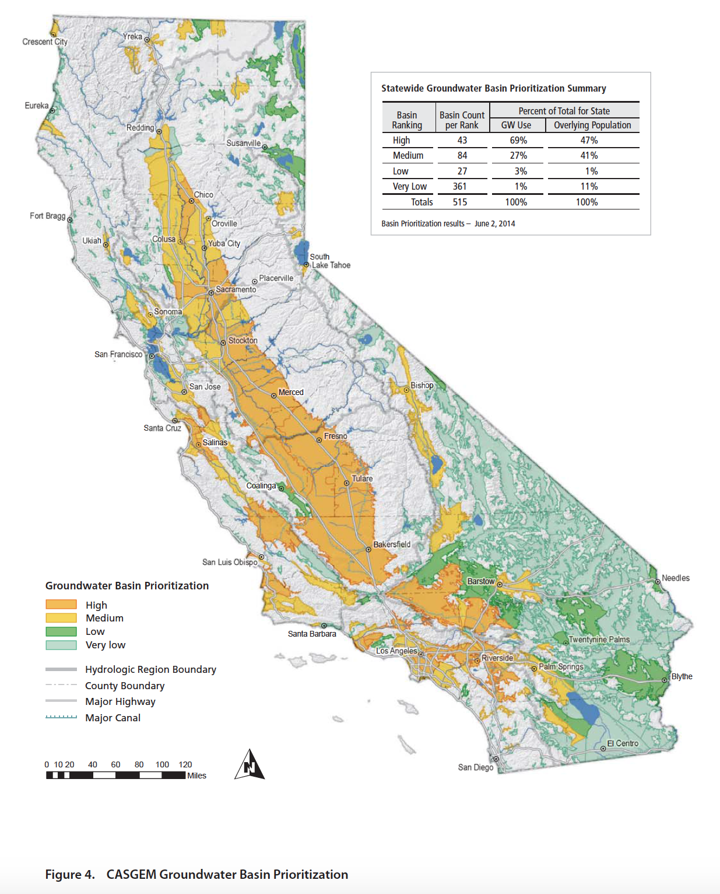
Sustainable Groundwater Management Act
Comprehensive bill passed in 2014 that is the first in the state to regulate groundwater
Requires formation of local GW sustainability agencies (GSAs) that create and help to adopt long-term GW sustainability plans:
GSA must:
Register GW wells
Measure and manage extraction
Generate reports
Designates medium and high priority basins

Slide 44
Water Supply Systems: Water Budgets and Groundwater Assessments
Notes:
Hello my name is Amber McCullum and I am a PhD Candidate at the University of California, Santa Cruz in the Environmental Studies Department. I am primarily advised by my co-authors, Dr. Brent Haddad and Dr. Renée Kidson.
Today I will be discussing the “Application of Empirical Mode Decomposition or EMD for Identification and Characterization of Long-run persistence in California reservoir inflows”.

Slide 45
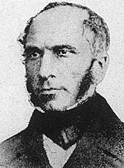
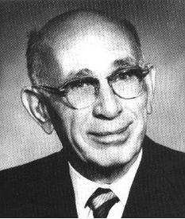
Groundwater Management
Two really important concepts:
Darcy’s Law: Movement of water through a porous medium
Theis equation: drawdown of water created by a pumping well
1856: Darcy’s Law
1929: Theis equations
Notes:
Darcy: French engineer: As a member of the Corps, he built an impressive pressurized water distribution system in Dijon following the failure of attempts to supply adequate fresh water by drilling wells. Chief engineer for water department
Charles V. Theis graduated with a PhD from the University of Cincinnati in June 1929 and made numerous contributions to the field of ground water science throughout his life.

Slide 46
Darcy’s Law
Darcy: Made first systematic study of movement of water through a porous medium and the first to state the simple law describing GW flow (1856)
Head Difference
Q = K
Area = KiA
Distance between Heads
Q = Volumetric discharge (L³/t)
i = Hydraulic Gradient (L/L)
K = Hydraulic conductivity (L/t)
Notes:
Hydraulic conductivity: a soil’s ability to transmit water when subjected to a gradient
Hydraulic head : a measure of the potential of water at the measurement point

Slide 47
Theis Equation
Theis: set of equations that describe the amount of drawdown created by a pumping well over a specific time period
Q
S =
W(u)
4πT
S = drawdown at any time and distance from a pumping well (L)
Q = discharge from pumping well (L³/t)
T = transmissivity of the aquifer (L²/t)
W(u) = Theis well function (unitless)

Slide 48
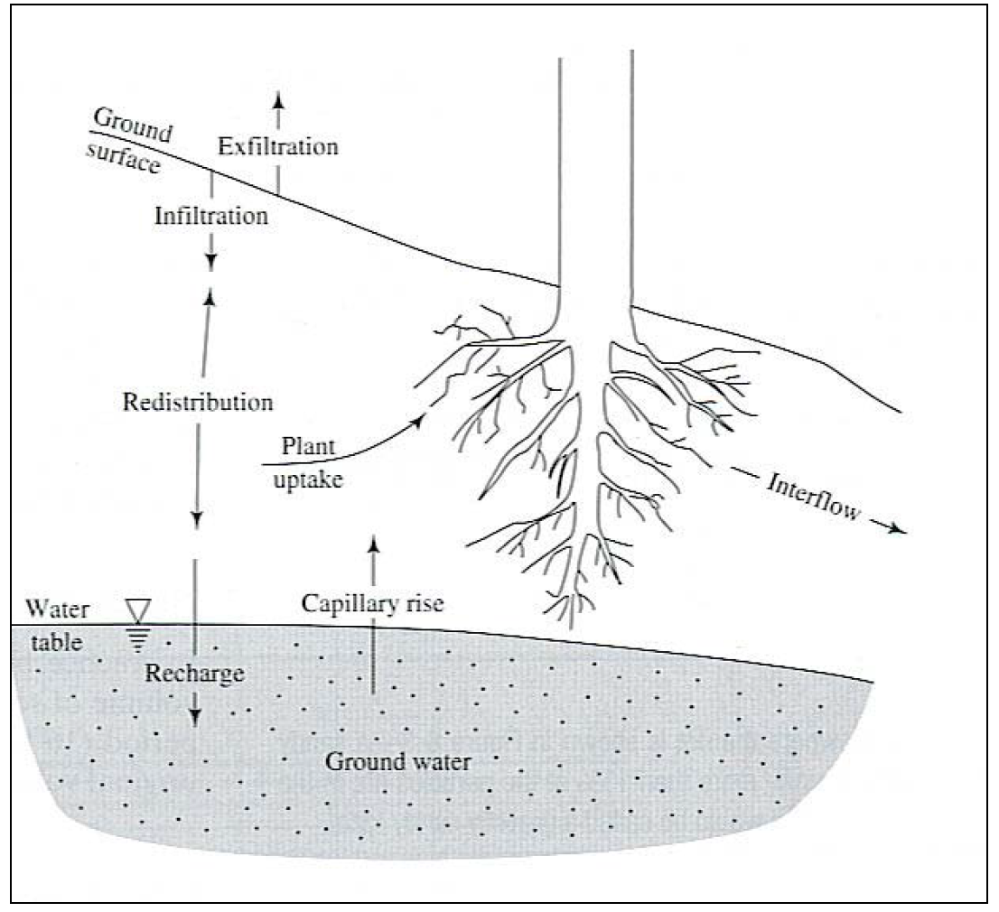
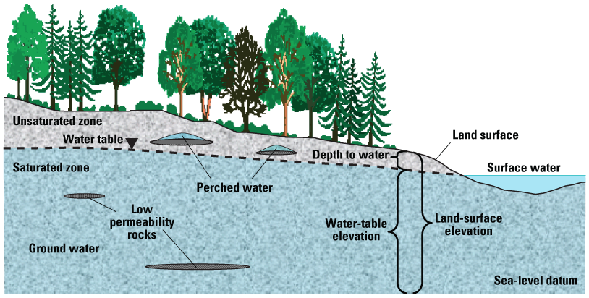
Groundwater Terminology
Infiltration: Water entering the soil across the land/atmosphere interface
Recharge: Flux of water to the water table
Water Table: Depth at which the soil becomes fully saturated

Slide 49
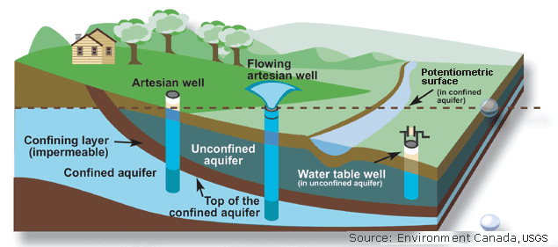
Groundwater Terminology
Unconfined Aquifer: are those into which water seeps from the ground surface directly above the aquifer
Confined Aquifer: are those in which an impermeable dirt/rock layer exists that prevents water from seeping into the aquifer from the ground surface located directly above.

Slide 50
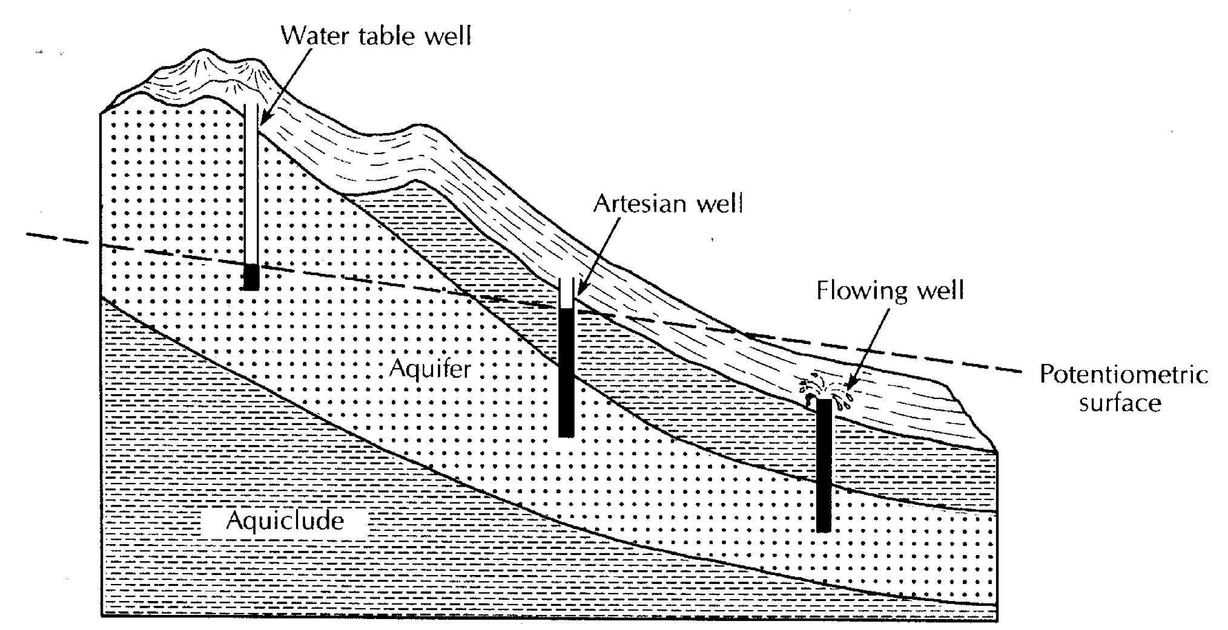
Groundwater Terminology
Potentiometric surface: The level to which water rises in a well
In a confined aquifer this surface is above the top of the aquifer
In unconfined aquifer it is the same as the water table
Notes:
The potentiometric surface is the level to which water rises in a well. In a confined aquifer this surface is above the top of the aquifer unit; whereas, in an unconfined aquifer, it is the same as the water table.
As you might expect, a potentiometric map is a contour map of the potentiometric surface. As on the surface of the earth, water flows from high elevation, or potential, to low elevation. Thus a potentiometric map indicates which direction water is moving in the subsurface.

Slide 51
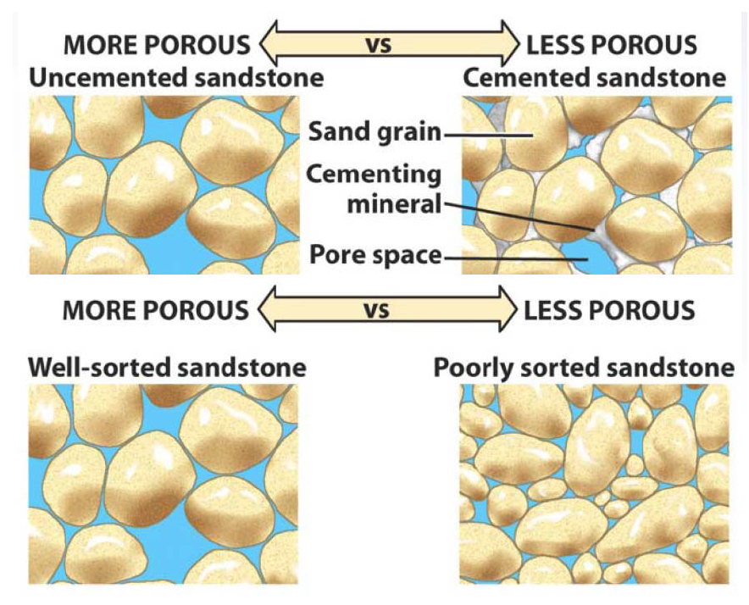
Groundwater Terminology
Porosity: fraction of soil occupied by void spaces
These spaces can be filled with water: determines maximum water holding capacity of a soil
Permeability: how easily water can flow through porous soil or bedrock

Slide 52
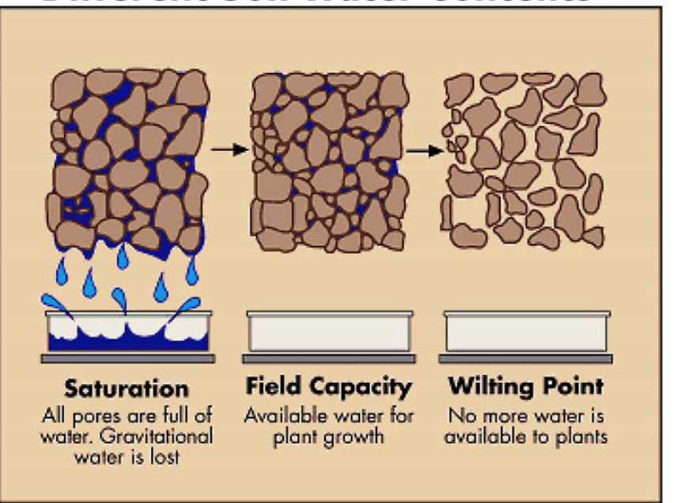
Groundwater Terminology
Soil Water Content: Amount of water contained in a soil
When soil is “saturated” the volumetric water content = porosity
Can be expressed as:
Volumetric water content
Gravimetric water content
Saturation ratio
Most often volumetric
Volume of water
Volume of soil

Slide 53
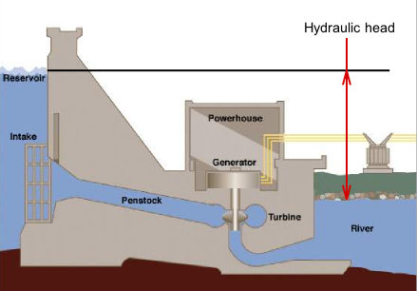
Groundwater Terminology
Hydraulic head : the potential of water at the measurement point
Water flows from high to low hydraulic head
Generally expressed as a gradient in units of length

Slide 54
Groundwater Terminology
Hydraulic gradient: Change in total head divided by the distance over which the change occurs
it causes water to move

Slide 55
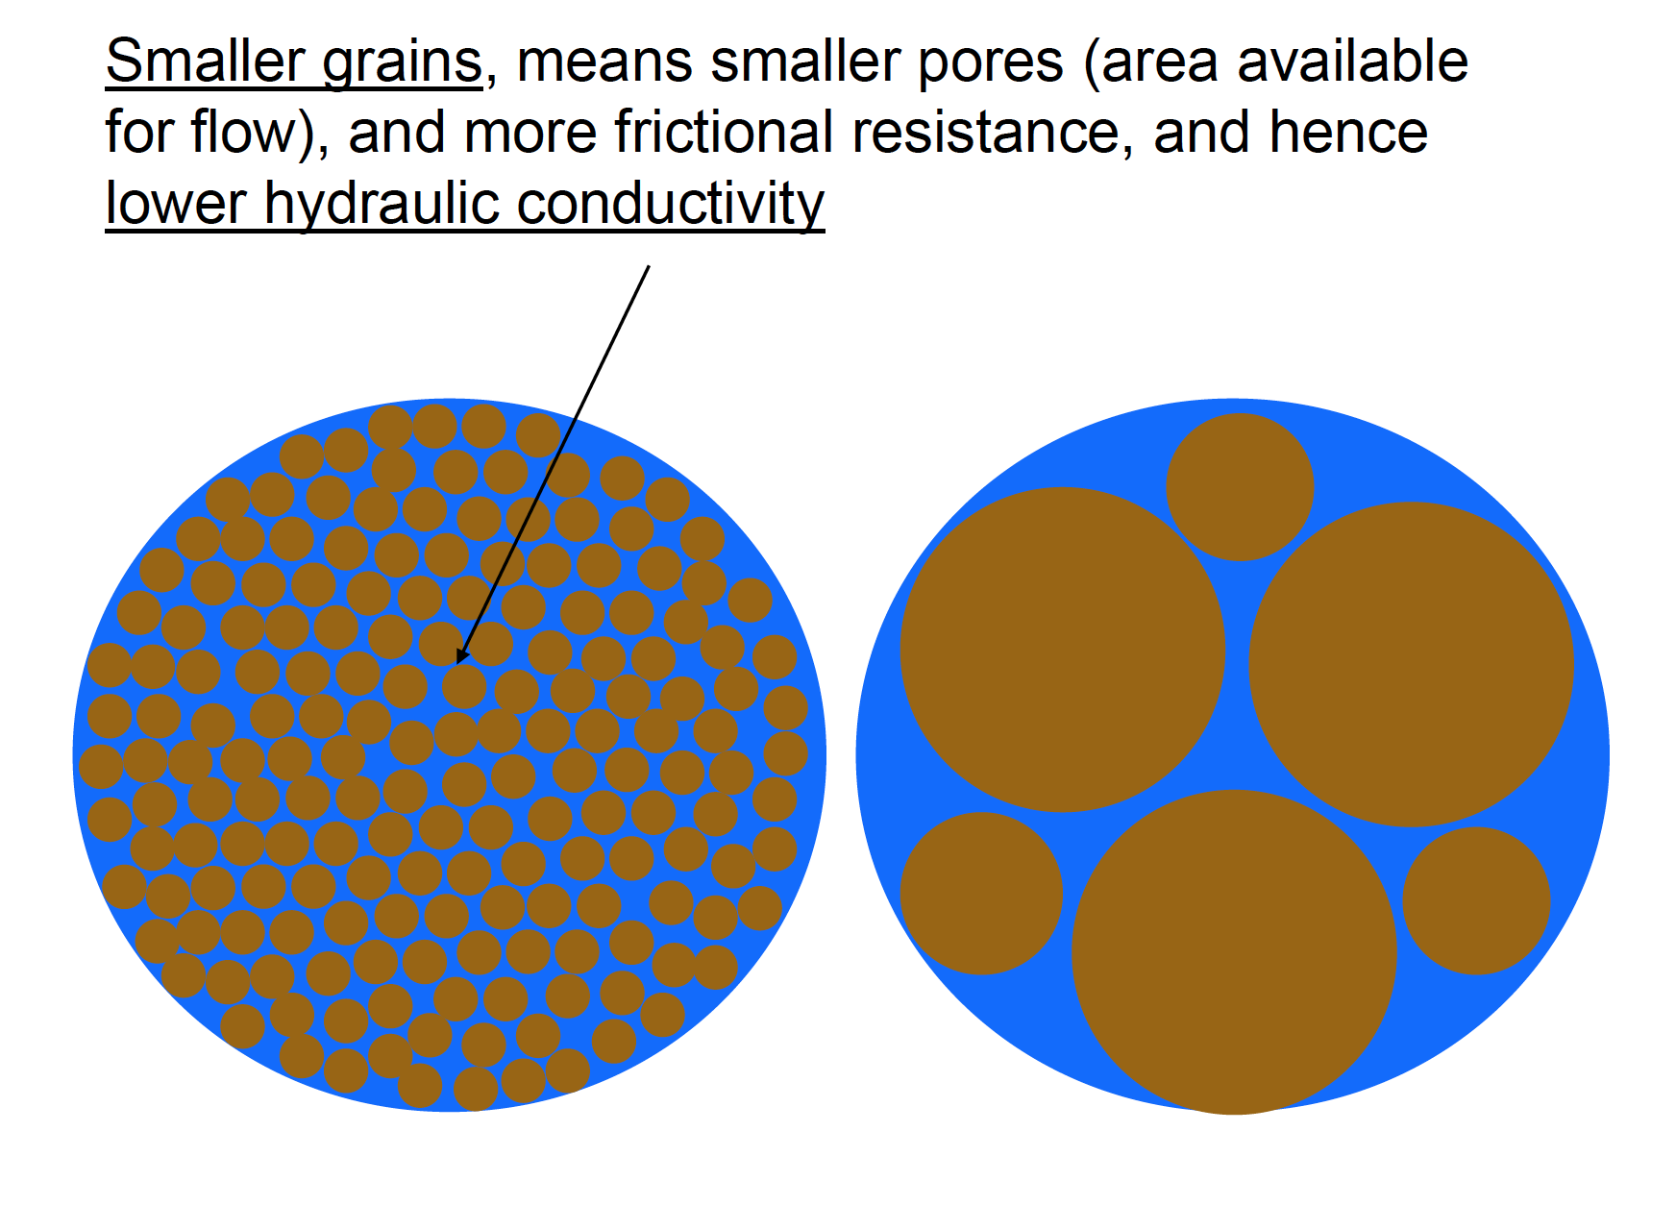
Groundwater Terminology
Hydraulic conductivity: a soil’s ability to transmit water when subjected to a gradient
Expressed as length/time
Related to permeability

Slide 56
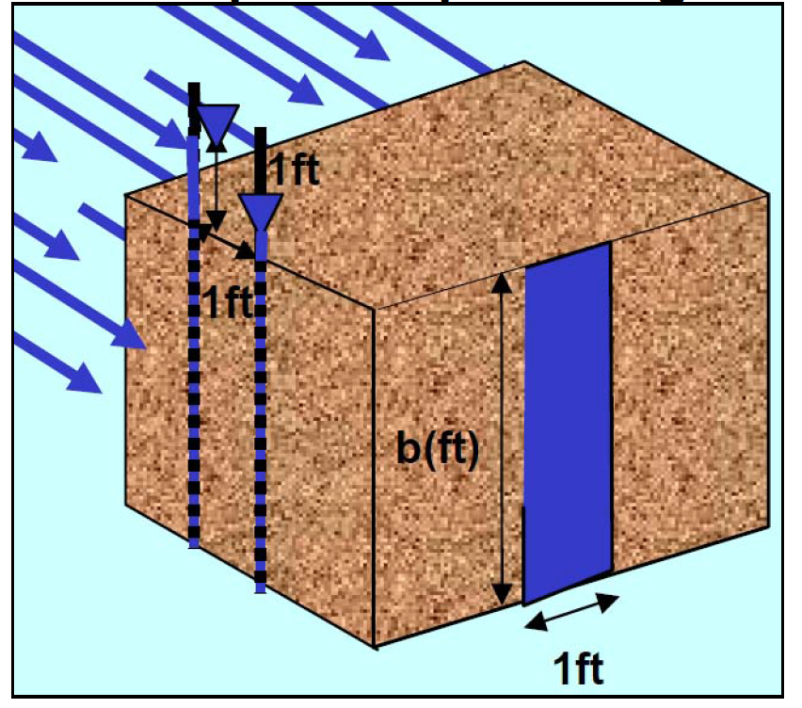
Groundwater Terminology
Transmissivity: rate of flow of water through a vertical strip of an aquifer
Expressed as area per unit time
Transmissivity = Hydraulic Conductivity x Aquifer Thickness
Notes:
Transmissivity: rate of flow of water through a vertical strip of an aquifer

Slide 57
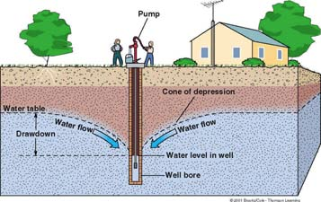
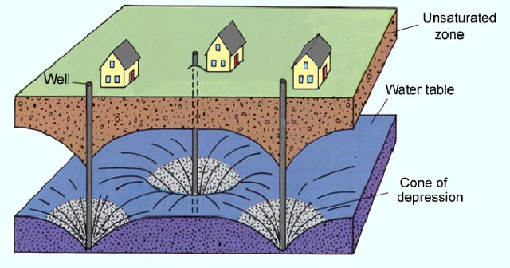
Groundwater Terminology
Drawdown: change in hydraulic head caused by well pumping
Cone of Depression: cone-shaped lowering of water observed in an aquifer caused by drawdown

Slide 58
Darcy’s Law
Darcy: Made first systematic study of movement of water through a porous medium and the first to state the simple law describing GW flow (1856)
Head Difference
Q = K
Area = KiA
Distance between Heads
Q = Volumetric discharge (L³/t)
i = Hydraulic Gradient (L/L)
K = Hydraulic conductivity (L/t)

Slide 59
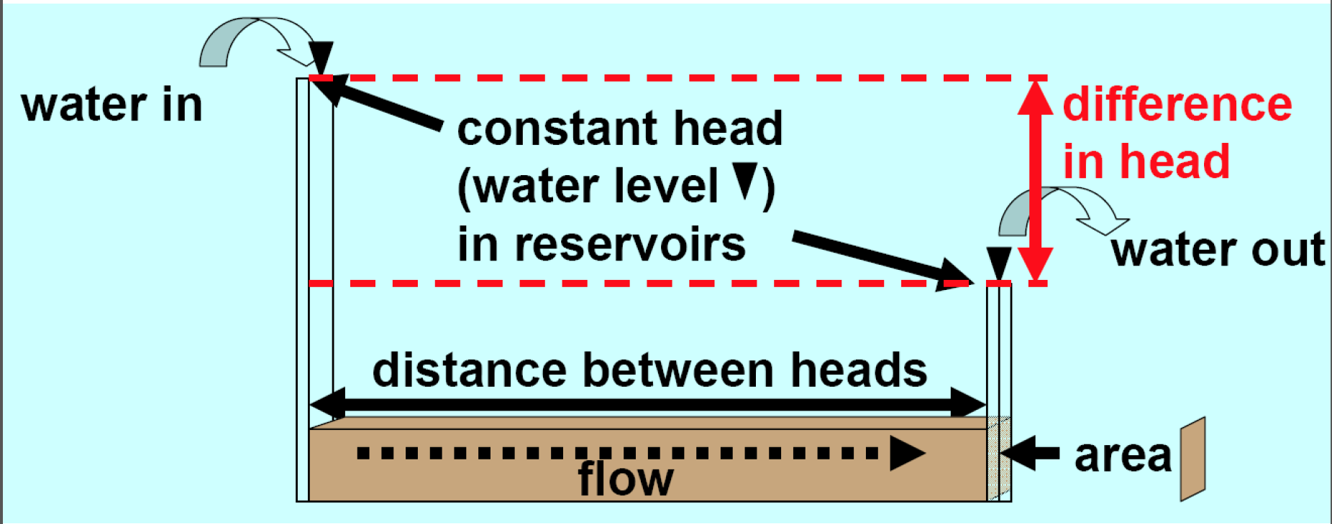
Darcy’s Law
Head Difference
Q = K
Area = KiA
Distance between Heads

Slide 60
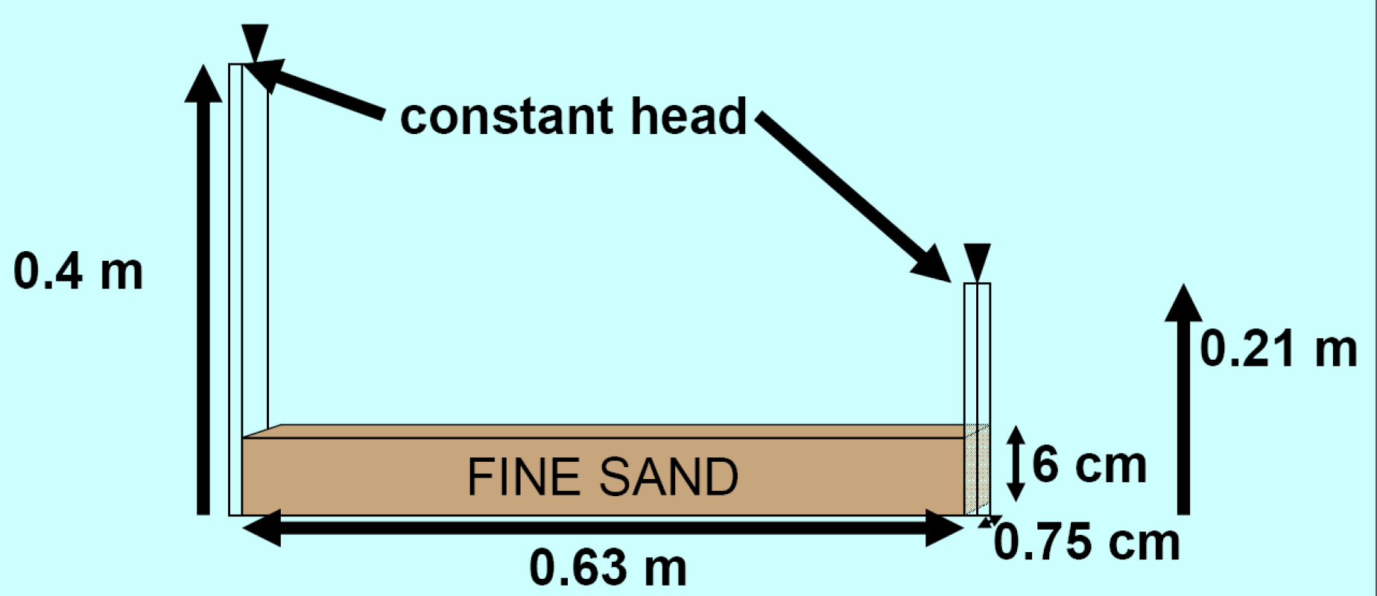
Darcy’s Law
Head Difference
Q = K
Area = KiA
Distance between Heads
K = 0.01 cm/s

Slide 61
What is the discharge in this aquifer in cubic feet per year?
…Or what is the volume of water flowing through the aquifer area per year??
Conversion Reminder:
1 m = 100 cm
1 m³ = 35.3 ft³

Slide 62
Darcy’s Law
Head Difference
Conversion Reminder:
1 m = 100 cm
1 m³ = 35.3 ft³
Q = K
Area = KiA
Distance between Heads
K = 0.01 cm/s

Slide 63
Darcy’s Law
Head Difference
Q = K
Area = KiA
Distance between Heads
K = 0.01 cm/s
(0.4 m – 0.21 m)
Q = 0.01 cm/s
(6 cm x 0.75 cm)
0.63 m
(0.19 m)
Q = 0.01 cm/s
(4.5 cm²)
0.63 m
Q = 0.013 cm³/s or 1.3 x10⁻⁸ m³/s

Slide 64
Darcy’s Law
Convert discharge to cubic feet per year
1 m³ = 35.3 ft³
Q = 1.3x10⁻⁸ m³/s

Slide 65
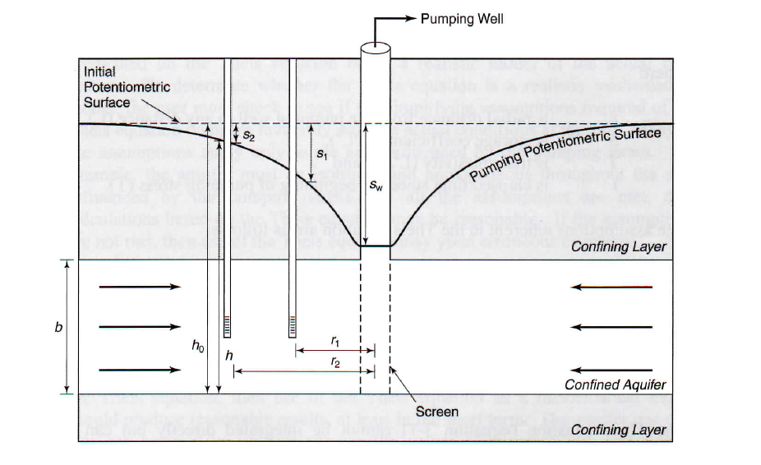
Theis and HW Review
Notes:
Conceptualization of radial flow to a fully penetrating pumping well: shows initial and pumping pot1ntiometric surfaces. Two observation wells at r1 and r2: show differences in spatial drawdowns in s1 and s2. Aquifer tickness is b

Slide 66
Theis Equation Parameter
r = radial distance from the pumping well to any distance (L)
S = coefficient of storage (L³/L³)
T = transmissivity of the aquifer (L²/t)
t = elapsed time since pumping began (t)
u = Theis equation parameter (unitless)

Slide 67
Theis Equation
Theis: set of equations that describe the amount of drawdown created by a pumping well over a specific time period
s = drawdown at any time and distance from a pumping well (L)
h_{o} = initial hydraulic head before pumping
h = hydraulic head at the same distance after some elapsed time
Q = discharge from pumping well (L³/t)
T = transmissivity of the aquifer (L²/t)
u = Theis equation parameter

Slide 68
Theis Equation
We can solve for integral using this expansion = W(u)
s = drawdown at any time and distance from a pumping well (L)
h_{o} = initial hydraulic head before pumping
h = hydraulic head at the same distance after some elapsed time
Q = discharge from pumping well (L³/t)
T = transmissivity of the aquifer (L²/t)
u = Theis equation parameter
W(u) = Theis well function (unitless)

Slide 69
Theis Equation
What does this mean????
2*(1*2) +
3*(1*2*3) -
4*(1*2*3*4)
Notes:
Factorials!

Slide 70
Theis Equation
s = drawdown at any time and distance from a pumping well (L)
Q = discharge from pumping well (L³/t)
T = transmissivity of the aquifer (L²/t)
u = Theis equation parameter (unitless)
W(u) = Theis well function (unitless)

Slide 71
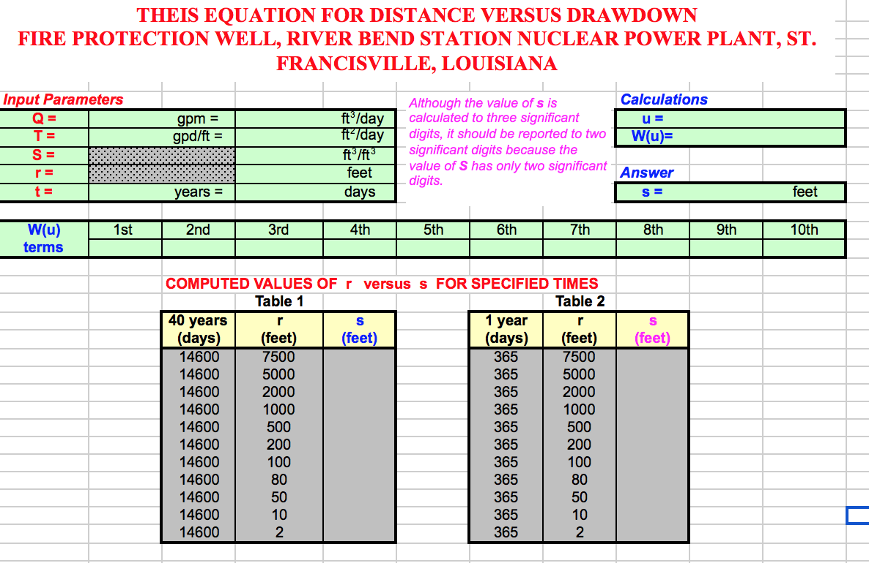

Slide 72
Q =
T =
S =
r =
t =
Discharge =
Transmissivity =
Storage Coefficient =
900 gpm Convert to ft³/day
35,200 gpd/ft Convert to ft²/day
0.00072
distance from pumping well =
7,500 ft
time =
40 years Convert to days
Helpful Conversion
1 gallon = 0.134 ft³
Notes:
Open up the HW pdf and show them the equations we just talked through.
Then, open up the 3.1 excel sheet:
Look at introduction
Have them name the parameters based on the paragraph: write those on the board
Talk through conversions of those parameter

Slide 73
In groups: Create excel calculation for the Theis parameter (u), the Theis well function (W(u), and the drawdown (s)
2*(1*2) +
3*(1*2*3) -
4*(1*2*3*4)
r = radial distance from the pumping well to any distance (L)
S = coefficient of storage (L³/L³)
T = transmissivity of the aquifer (L²/t)
t = elapsed time since pumping began (t)
u = Theis equation parameter (unitless)
W(u)

Slide 74
Conversions:
Q = 900 gpm (gallons per minute) into ft³/day
1 gallon = 0.134 ft³

Slide 75
Conversions:
T = 35,200 gpd/ft (gallons per day per foot)
1 gallon = 0.134 ft³

Slide 76
Conversions:
t = 40 years

Slide 77
In groups: Create excel calculation for the Theis parameter (u)
How did you create this calculation in excel?
r = radial distance from the pumping well to any distance (L)
S = coefficient of storage (L³/L³)
T = transmissivity of the aquifer (L²/t)
t = elapsed time since pumping began (t)
u = Theis equation parameter (unitless)

Slide 78
Now, calculate entire W(u) term:
How did you create this calculation in excel?

Slide 79
Next, calculate S for the 40 year period in excel
How did you create this calculation in excel?
s = drawdown at any time and distance from a pumping well (L)
Q = discharge from pumping well (L³/t)
T = transmissivity of the aquifer (L²/t)
u = Theis equation parameter (unitless)
W(u) = Theis well function (unitless)

Slide 80
For the next steps in the homework you will need to change the distance from the pumping well to see what the cone of depression looks like.
If you have your excel equations programmed correctly and you change the r value, the other parameters (u, W(u), and s) will change.
Then, fill in the W(u) values into that portion of the spreadsheet and fill in each value of s into Table 1 and 2 as the distances change.
This will automatically create the drowndown figures below

